Slide 1
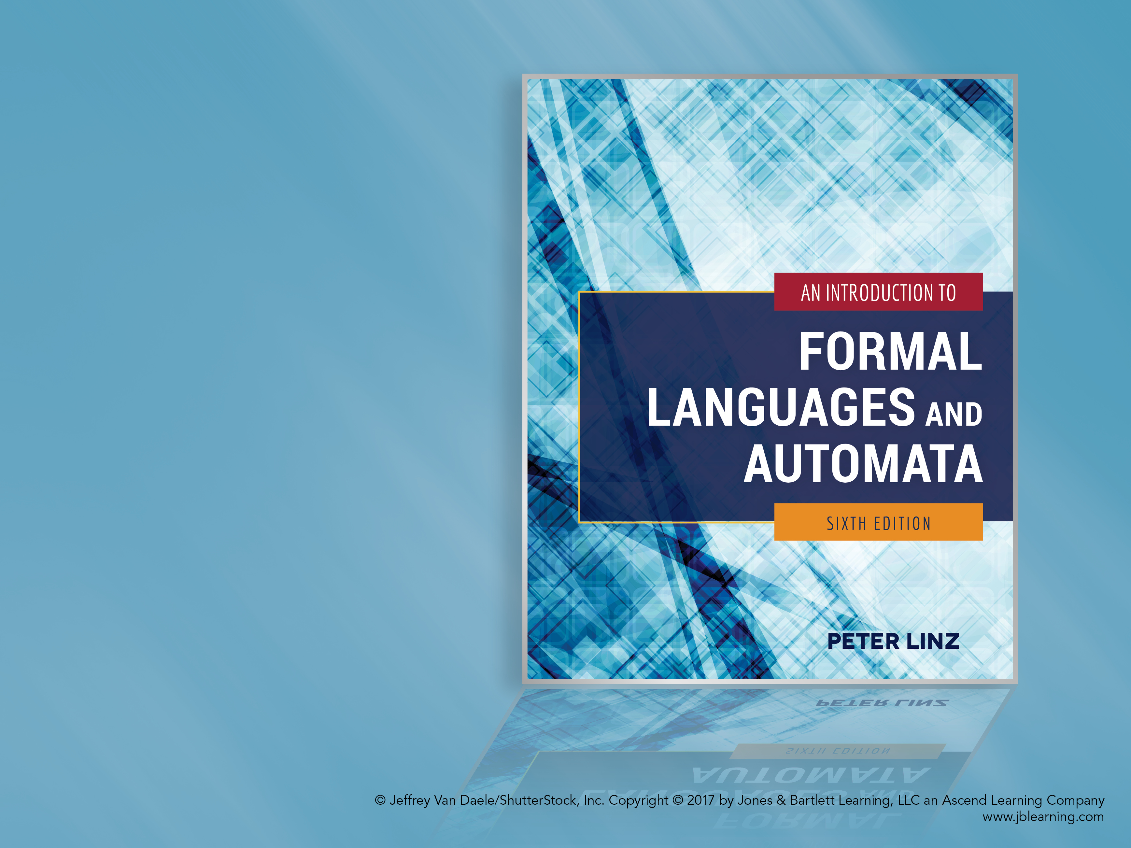
Chapter 9
TURING MACHINES

Slide 2

Learning Objectives At the conclusion of the chapter, the student will be able to:
Describe the components of a standard Turing machine
State whether an input string is accepted by a Turing machine
Construct a Turing machine to accept a specific language
Trace the operation of a Turing machine transducer given a sample input string
Construct a Turing machine to compute a simple function
State Turing’s thesis and discuss the circumstantial evidence supporting it

Slide 3
The Standard Turing Machine
A standard Turing machine has unlimited storage in the form of a tape consisting of an infinite number of cells, with each cell storing one symbol
The read-write head can travel in both directions, processing one symbol per move
A deterministic control function causes the machine to change states and possibly overwrite the tape contents
Input string is surrounded by blanks, so the input alphabet is considered a proper subset of the tape alphabet

Slide 4
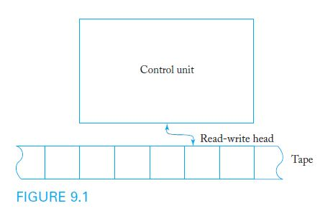
Diagram of a Standard Turing Machine
In a standard Turing machine, the tape acts as the input, output, and storage medium.

Slide 5
Definition of a Turing Machine
A Turing Machine is defined by:
A finite set of internal states Q
An input alphabet Σ
A tape alphabet Γ
A transition function δ
A special symbol from Γ called the blank
An initial state q₀
A set of final states F
Input to the transition function δ consists of the current state of the control unit and the current tape symbol
Output of δ consists of a new state, new tape symbol, and location of the next symbol to be read (L or R)
δ is a partial function, so that some (state, symbol) input combinations may be undefined

Slide 6
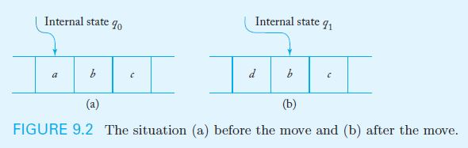
Sample Turing Machine Transition
Example 9.1 presents the sample transition rule:
δ(q₀, a) = (q₁, d, R)
According to this rule, when the control unit is in state q₀ and the tape symbol is a, the new state is q₁, the symbol d replaces a on the tape, and the read-write head moves one cell to the right

Slide 7
A Sample Turing Machine
Example 9.2: Consider the Turing machine
Q = { q₀, q₁ }, Σ = { a, b }, Γ= { a, b, }, F = { q₁ }
with initial state q₀ and transition function given by:
δ(q₀, a) = (q₀, b, R)
δ(q₀, b) = (q₀, b, R)
δ(q₀, ) = (q₁, , L)
The machine starts in q₀ and, as long as it reads a’s, will replace them with b’s and continue moving to the right, but b’s will not be modified
When a blank is found, the control unit switches states to q₁ and moves one cell to the left
The machine halts whenever it reaches a configuration for which δ is not defined (in this case, state q₁)

Slide 8
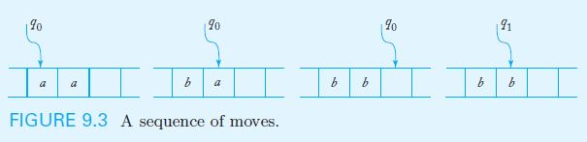
Tracing the Operation of a Turing Machine
Figure 9.3 shows several stages of the operation of the Turing Machine in Example 9.2 as it processes a tape with initial contents aa

Slide 9
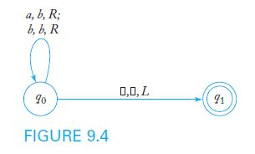
Transition Graphs for Turing Machines
In a Turing machine transition graph, each edge is labeled with three items: current tape symbol, new tape symbol, and direction of the head move
Figure 9.4 shows the transition graph for the Turing Machine in Example 9.2

Slide 10
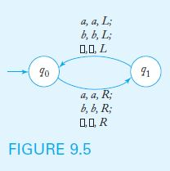
A Turing Machine that Never Halts
It is possible for a Turing machine to never halt on certain inputs, as is the case with Example 9.3 (below) and input string ab
The machine runs forever –in an infinite loop- with the read-write head moving alternately right and left, but making no modifications to the tape

Slide 11
The Language Accepted by a Turing Machine
Turing machines can be viewed as language accepters
The language accepted by a Turing machine is the set of all strings which cause the machine to halt in a final state, when started in its standard initial configuration (q₀, leftmost input symbol)
A string is rejected if
The machine halts in a nonfinal state, or
The machine never halts

Slide 12
Turing Machines as Transducers
Turing machines provide an abstract model for digital computers, acting as a transducer that transforms input into output
A Turing machine transducer implements a function that treats the original contents of the tape as its input and the final contents of the tape as its output
A function is Turing-computable if it can be carried out by a Turing machine capable of processing all values in the function domain

Slide 13
A Sample Turing Machine Transducer
Given two positive integers x and y in unary notation, separated by a single zero, the Turing machine below computes the function x + y
The transducer has Q = { q₀, q₁, q_{2,} q₃, q₄ } with initial state q₀ and final state q₄
The defined values of the transition function are
δ(q₀, 1) = (q₀, 1, R) δ(q₀, 0) = (q₁, 1, R)
δ(q₁, 1) = (q₁, 1, R) δ(q₁, ) = (q₂, , L)
δ(q₂, 1) = (q₃, 0, L) δ(q₃, 1) = (q₃, 1, L)
δ(q₃, ) = (q₄, , R)
When the machine halts, the read-write head is positioned on the leftmost symbol of the unary representation of x + y

Slide 14
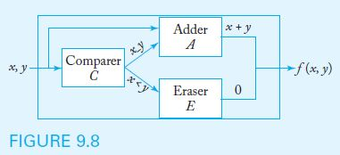
Combining Turing Machines
By combining Turing Machines that perform simple tasks, complex algorithms can be implemented
For example, assume the existence of a machine to compare two numbers (comparer), one to add two numbers (adder), and one to erase the input (eraser)
Figure 9.8 shows the diagram of a Turing Machine that computes the function f(x, y) = x + y (if x ≥ y), 0 (if x < y)

Slide 15
Turing’s Thesis
How powerful are Turing machines?
Turing’s Thesis contends that any computation carried out by mechanical means can be performed by some Turing machine
An acceptance of Turing’s Thesis leads to a definition of an algorithm:
An algorithm for a function f : D → R is a Turing machine M, which given any d ∈ D on its tape, eventually halts with the correct answer f(d) ∈ R on its tape

Slide 16
Evidence Supporting Turing’s Thesis
Anything that can be done on any existing digital computer can also be done by a Turing machine
No one has yet been able to suggest a problem, solvable by what we intuitively consider an algorithm, for which a Turing machine program cannot be written
Alternative models have been proposed for mechanical computation, but none of them is more powerful than the Turing machine model

